Slide 1

Demand Shock along the Supply Chain: The Bullwhip Effect of Covid-19 in Chinese Exports
Kaichong (Matt) Zhang
Advisor: Felix L Friedt
Department of Economics
Macalester College

Slide 2
Covid-19 and the Bullwhip Effect
The Bullwhip effect refers to the amplification of order volatility along the supply chain (Wang & Disney, 2016).
Altomonte et al. (2012) and Zavacka (2012) demonstrate the amplification of initial demand shock along the supply chain and argue that the bullwhip effect was mainly caused by the excessive adjustment of production and inventory to new expectation.
Notes:
the demand shock at the consumer end first affect the most downstream industries and then their upstream suppliers, and because of the need for inventory adjustment in response to the shift in demand, the volatility of industrial output is magnified from downstream to upstream producers.

Slide 3
Theoretical Model
Assumption 1: there are n+1 stages along the supply chain
stage n
stage 0
Upstream industry
Downstream industry
Notes:
The following model is built on the works from Altomonte, Di Mauro, Ottaviano, Rungi, and Vicard (2012) and Zavacka (2012) who analyzing the bullwhip effect during 2008 Global Trade Collapse.

Slide 4
Theoretical Model
Assumption 2: Producers will adjust the amount of inventory according to the demand for their product.
Producers intend to hold α percent of demand as inventory.
Producers restock at time t to meet the demand at time t-1
Cell phone retailer
Demand: 50
Demand for Inventory 25
α = 50%
Demand: 40
Demand for Inventory 20
α = 50%
Demand: 30
Demand for Inventory 15
α = 50%
Timeline
t-1
t
t+1
Notes:
The following model is built on the works from Altomonte, Di Mauro, Ottaviano, Rungi, and Vicard (2012) and Zavacka (2012) who analyzing the bullwhip effect during 2008 Global Trade Collapse.

Slide 5
Two-Stage Model
Cell phone retailer
Demand: 50
Actual Inventory: 25
Demand for inventory: 25
Demand: 40
Actual Inventory: 25
Demand for inventory: 20
Demand: 30
Actual Inventory: 20
Demand for inventory: 15
Timeline
t-1
t
t+1
Cell phone producers
Demand: 50
Demand: 35
Demand: 20
Timeline
t-1
t
t+1
t+2
Notes:
The following model is built on the works from Altomonte, Di Mauro, Ottaviano, Rungi, and Vicard (2012) and Zavacka (2012) who analyzing the bullwhip effect during 2008 Global Trade Collapse.

Slide 6
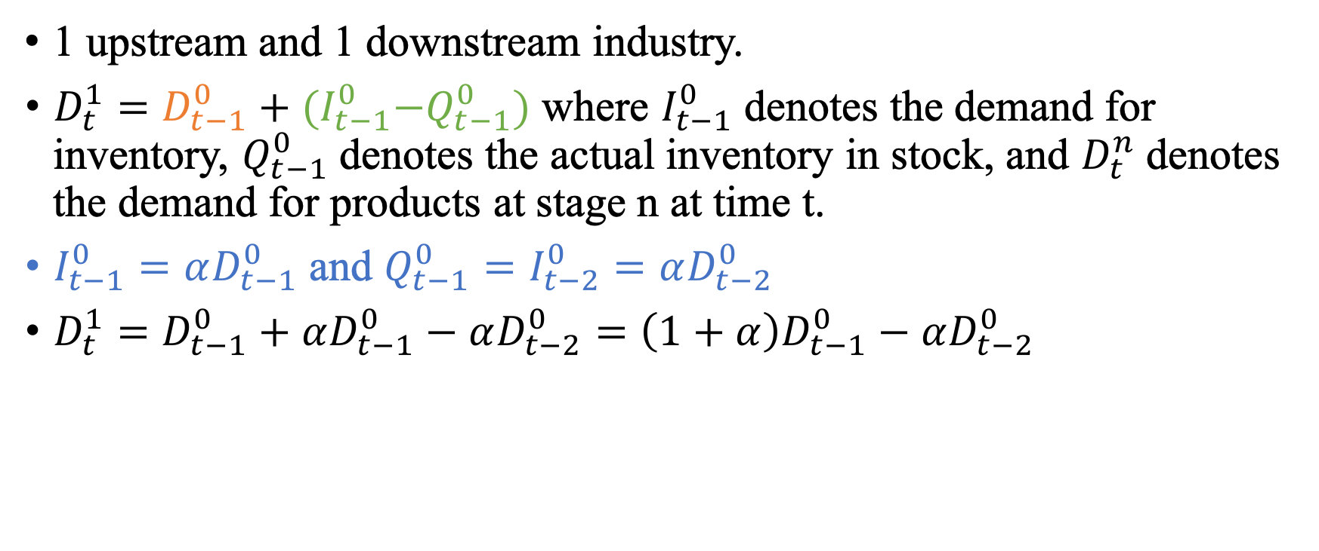
Two-Stage Model
1 upstream and 1 downstream industry.
$D_{t}^{1}=D_{t−1}^{0}+{(I}_{t−1}^{0}−Q_{t−1}^{0})$ where $I_{t−1}^{0}$ denotes the demand for inventory, $Q_{t−1}^{0}$ denotes the actual inventory in stock, and $D_{t}^{n}$ denotes the demand for products at stage n at time t.
$I_{t−1}^{0}=αD_{t−1}^{0}$ and $Q_{t−1}^{0}=I_{t−2}^{0}=αD_{t−2}^{0}$
$D_{t}^{1}=D_{t−1}^{0}+αD_{t−1}^{0}−αD_{t−2}^{0}=\left(1+α\right)D_{t−1}^{0}−αD_{t−2}^{0}$
Notes:
The following model is built on the works from Altomonte, Di Mauro, Ottaviano, Rungi, and Vicard (2012) and Zavacka (2012) who analyzing the bullwhip effect during 2008 Global Trade Collapse.

Slide 7
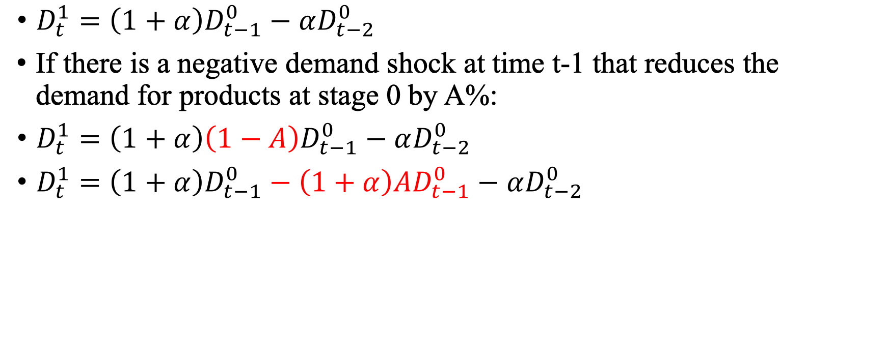
Two-Stage Model
$D_{t}^{1}=\left(1+α\right)D_{t−1}^{0}−αD_{t−2}^{0}$
If there is a negative demand shock at time t-1 that reduces the demand for products at stage 0 by A%:
$D_{t}^{1}=\left(1+α\right)\left(1−A\right)D_{t−1}^{0}−αD_{t−2}^{0}$
$D_{t}^{1}=\left(1+α\right)D_{t−1}^{0}−\left(1+α\right){AD}_{t−1}^{0}−αD_{t−2}^{0}$
Notes:
The following model is built on the works from Altomonte, Di Mauro, Ottaviano, Rungi, and Vicard (2012) and Zavacka (2012) who analyzing the bullwhip effect during 2008 Global Trade Collapse.

Slide 8
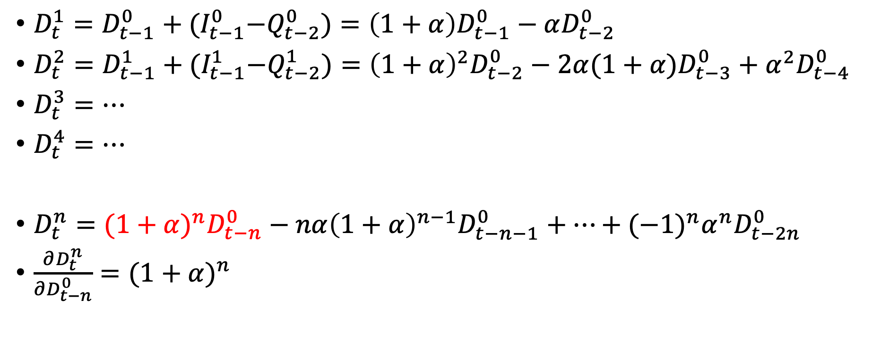
N-Stage Model
$D_{t}^{1}=D_{t−1}^{0}+{(I}_{t−1}^{0}−Q_{t−2}^{0})=\left(1+α\right)D_{t−1}^{0}−αD_{t−2}^{0}$
$D_{t}^{2}=D_{t−1}^{1}+{(I}_{t−1}^{1}−Q_{t−2}^{1})={\left(1+α\right)}^{2}D_{t−2}^{0}−2α(1+α)D_{t−3}^{0}+α^{2}D_{t−4}^{0}$
$D_{t}^{3}=…$
$D_{t}^{4}=…$
$D_{t}^{n}={(1+α)}^{n}D_{t−n}^{0}−nα{\left(1+α\right)}^{n−1}D_{t−n−1}^{0}+…+{(−1)}^{n}α^{n}D_{t−2n}^{0}$
$\frac{∂D_{t}^{n}}{∂D_{t−n}^{0}}={(1+α)}^{n}$
Notes:
The following model is built on the works from Altomonte, Di Mauro, Ottaviano, Rungi, and Vicard (2012) and Zavacka (2012) who analyzing the bullwhip effect during 2008 Global Trade Collapse.

Slide 9
Key Takeaways
Upstream industries at time t tend to suffer from an lagged amplified demand shock that hits downstream industries at time t-n

Slide 10

N-Stage Model with Concentration
stage 0
Complements and substitutes
stage n
Upstream Industry
Downstream Industry

Slide 11
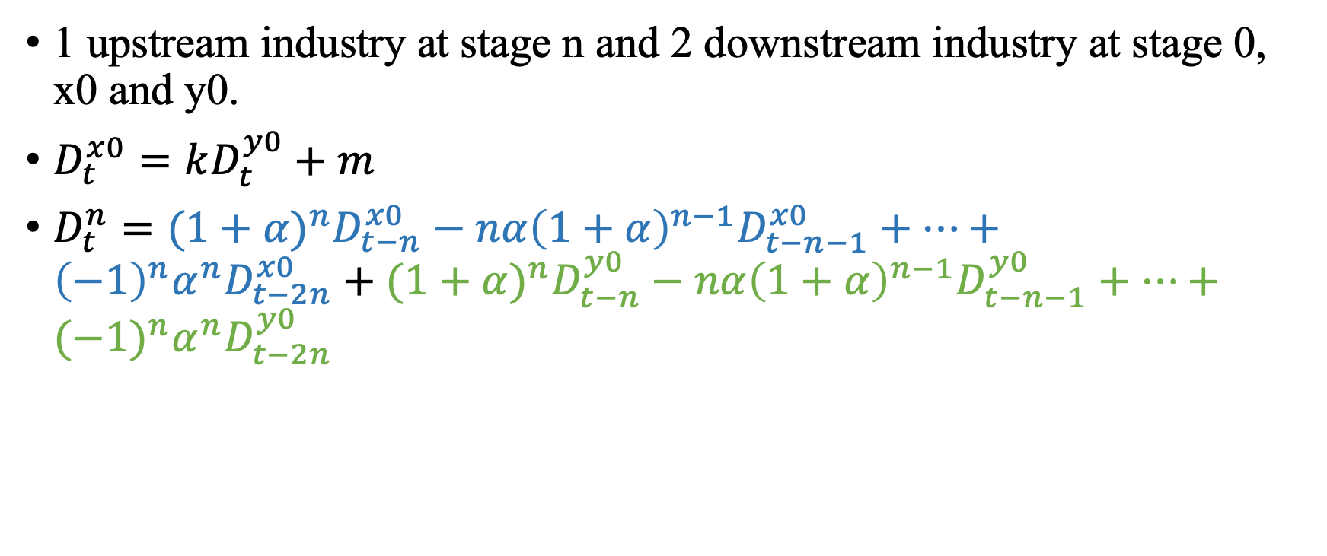
N-Stage Model with Concentration
1 upstream industry at stage n and 2 downstream industry at stage 0, x0 and y0.
$D_{t}^{x0}=kD_{t}^{y0}+m$
$D_{t}^{n}={(1+α)}^{n}D_{t−n}^{x0}−nα{\left(1+α\right)}^{n−1}D_{t−n−1}^{x0}+…+{\left(−1\right)}^{n}α^{n}D_{t−2n}^{x0}+{(1+α)}^{n}D_{t−n}^{y0}−nα{\left(1+α\right)}^{n−1}D_{t−n−1}^{y0}+…+{(−1)}^{n}α^{n}D_{t−2n}^{y0}$

Slide 12
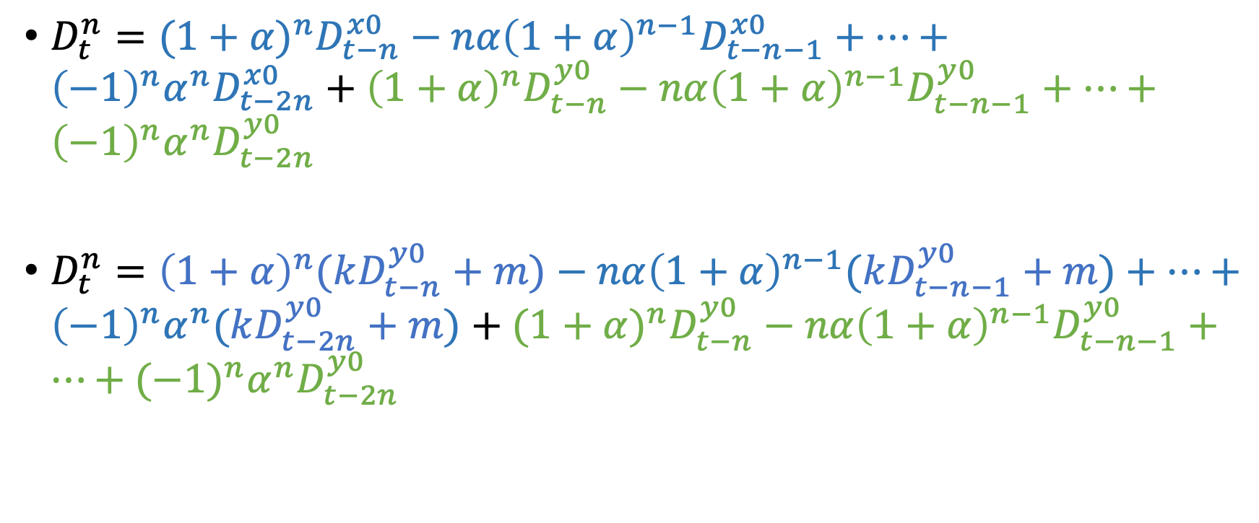
N-Stage Model with Concentration
$D_{t}^{n}={(1+α)}^{n}D_{t−n}^{x0}−nα{\left(1+α\right)}^{n−1}D_{t−n−1}^{x0}+…+{\left(−1\right)}^{n}α^{n}D_{t−2n}^{x0}+{\left(1+α\right)}^{n}D_{t−n}^{y0}−nα{\left(1+α\right)}^{n−1}D_{t−n−1}^{y0}+…+{\left(−1\right)}^{n}α^{n}D_{t−2n}^{y0}$
$D_{t}^{n}={\left(1+α\right)}^{n}(kD_{t−n}^{y0}+m)−nα{\left(1+α\right)}^{n−1}(kD_{t−n−1}^{y0}+m)+…+{\left(−1\right)}^{n}α^{n}(kD_{t−2n}^{y0}+m)+{(1+α)}^{n}D_{t−n}^{y0}−nα{\left(1+α\right)}^{n−1}D_{t−n−1}^{y0}+…+{(−1)}^{n}α^{n}D_{t−2n}^{y0}$

Slide 13

N-Stage Model with Concentration
$D_{t}^{n}={\left(1+α\right)}^{n}(kD_{t−n}^{y0}+m)−nα{\left(1+α\right)}^{n−1}(kD_{t−n−1}^{y0}+m)+…+{\left(−1\right)}^{n}α^{n}(kD_{t−2n}^{y0}+m)+{(1+α)}^{n}D_{t−n}^{y0}−nα{\left(1+α\right)}^{n−1}D_{t−n−1}^{y0}+…+{(−1)}^{n}α^{n}D_{t−2n}^{y0}$
$\frac{∂D_{t}^{n}}{∂D_{t−n}^{y0}}={(1+k)(1+α)}^{n}$ N-Stage Model with Concentration
$\frac{∂D_{t}^{n}}{∂D_{t−n}^{0}}={(1+α)}^{n}$ N-Stage Model

Slide 14
Key Takeaways
Upstream industries at time t tend to suffer from an lagged amplified demand shock that hits downstream industries at time t-n
Diversification matters. Non-concentrated industries might suffer from a amplified demand shock if their downstream products are complements, and vice versa.

Slide 15
Data Summary
Sources:
2 digit Trade Data from 2019 to 2020 from General Administration of Customs China (GACC)
Covid Data from China’s National Health Commission and the European Center for Disease Prevention and Control (ECDC)
Upstreamness Data is from Measuring the Upstreamness of Production and Trade Flows (Pol Antràs, Davin Chor, Thibault Fally, and Russell Hillberry, 2012)
Concentration Data from IO table published by Asian Development Bank
Restrictions:
US excluded
Only commodities with quality upstreamness and concentration index are included
Only foreign countries that report complete Covid data are included

Slide 16
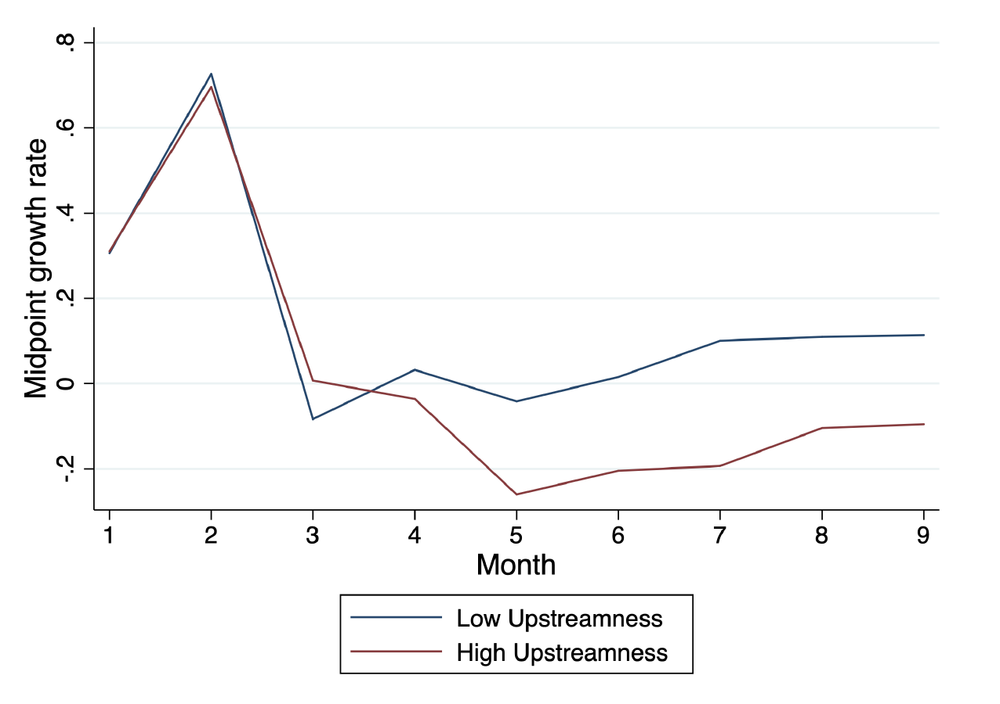
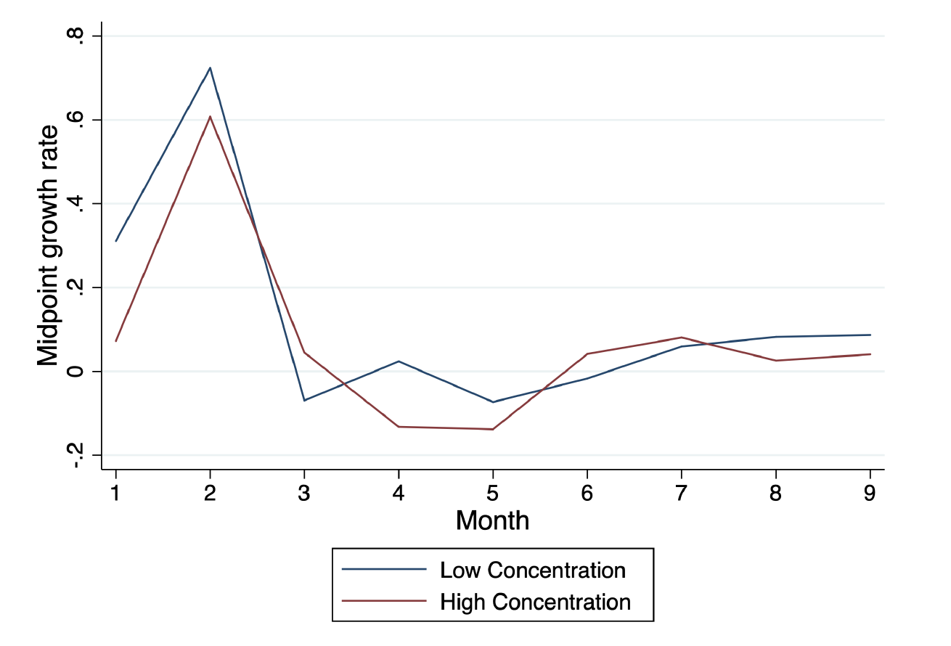
Data Summary

Slide 17
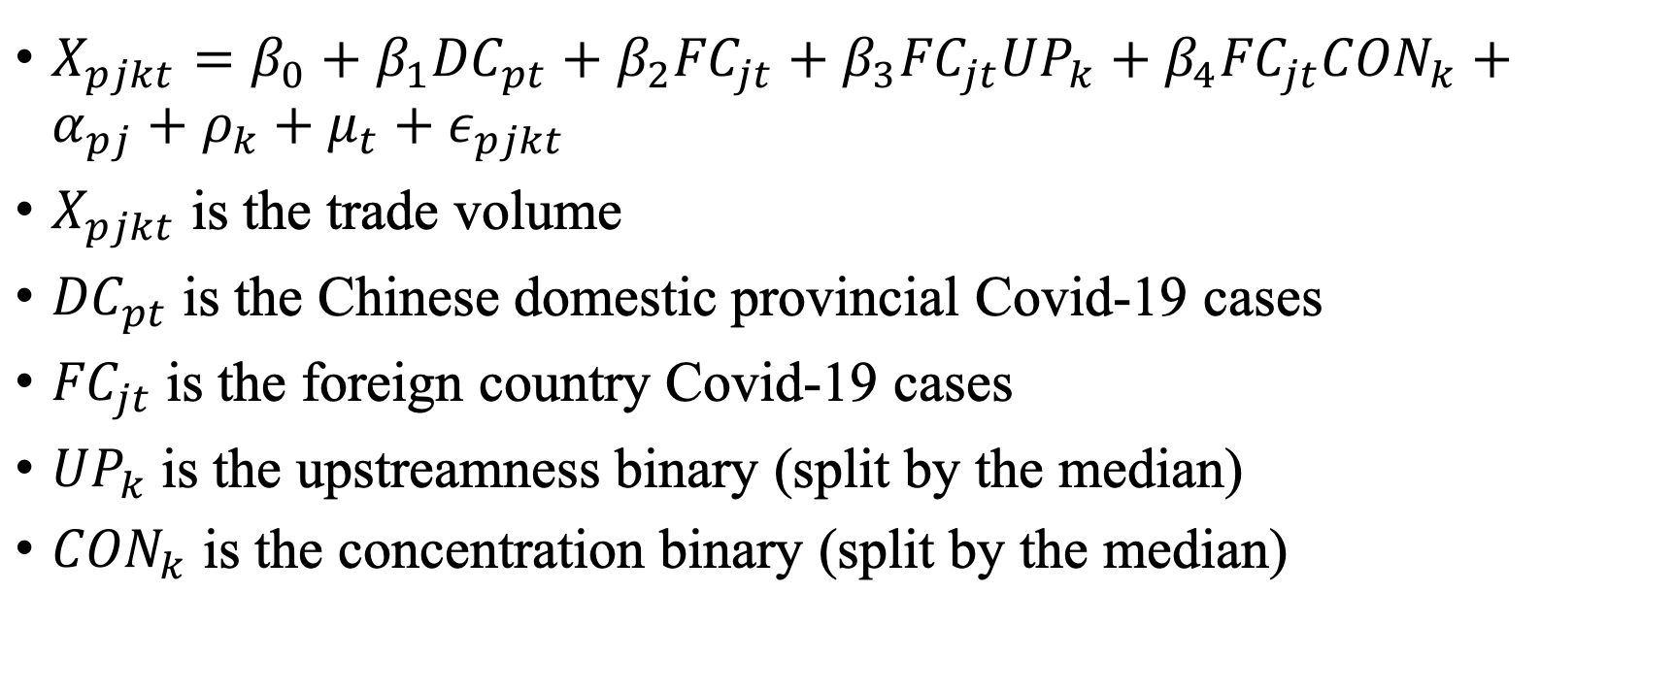
Empirical Result
$X_{pjkt}=β_{0}+β_{1}{DC}_{pt}+β_{2}{FC}_{jt}+β_{3}{{FC}_{jt}UP}_{k}+β_{4}{{FC}_{jt}CON}_{k}+α_{pj}+ρ_{k}+μ_{t}+ε_{pjkt}$
$X_{pjkt}$ is the trade volume
${DC}_{pt}$ is the Chinese domestic provincial Covid-19 cases
${FC}_{jt}$ is the foreign country Covid-19 cases
${UP}_{k}$ is the upstreamness binary (split by the median)
${CON}_{k}$ is the concentration binary (split by the median)

Slide 18
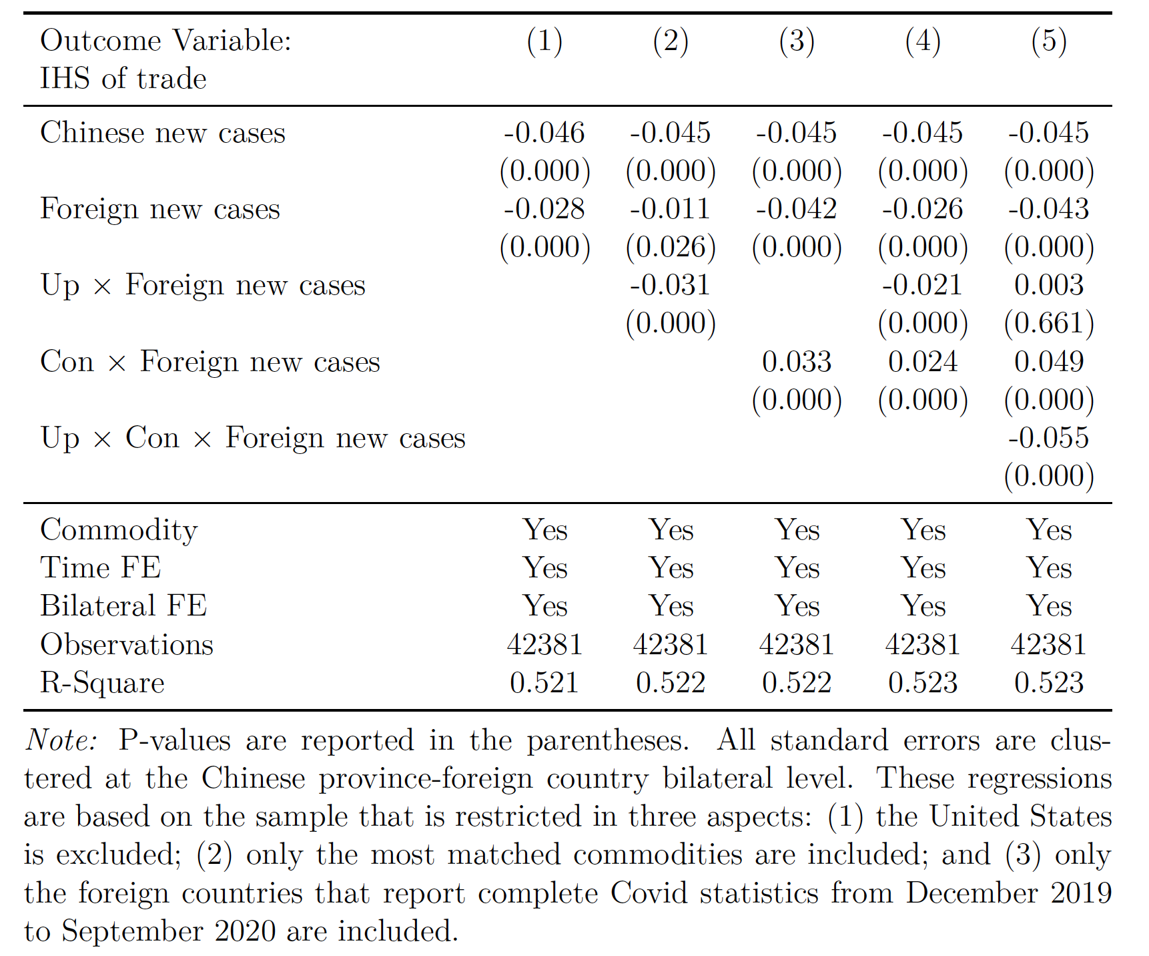
Baseline Estimates
Downstream and non-concentrated
If upstream
If concentrated

Slide 19
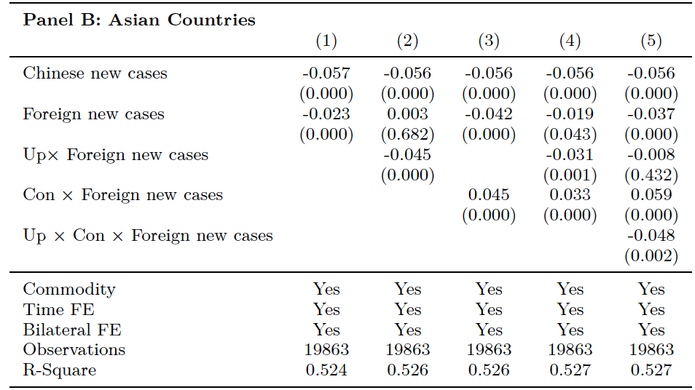
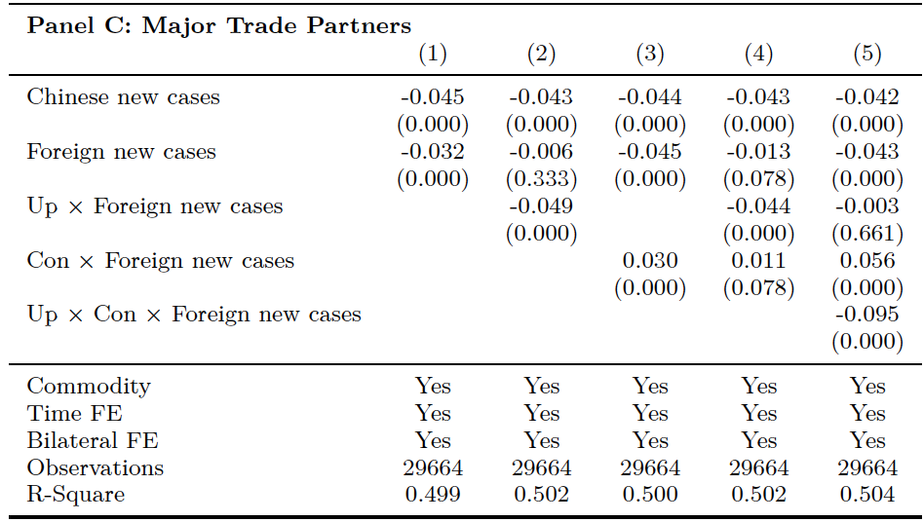
Geographic Heterogeneity Analysis
Full sample:

Slide 20
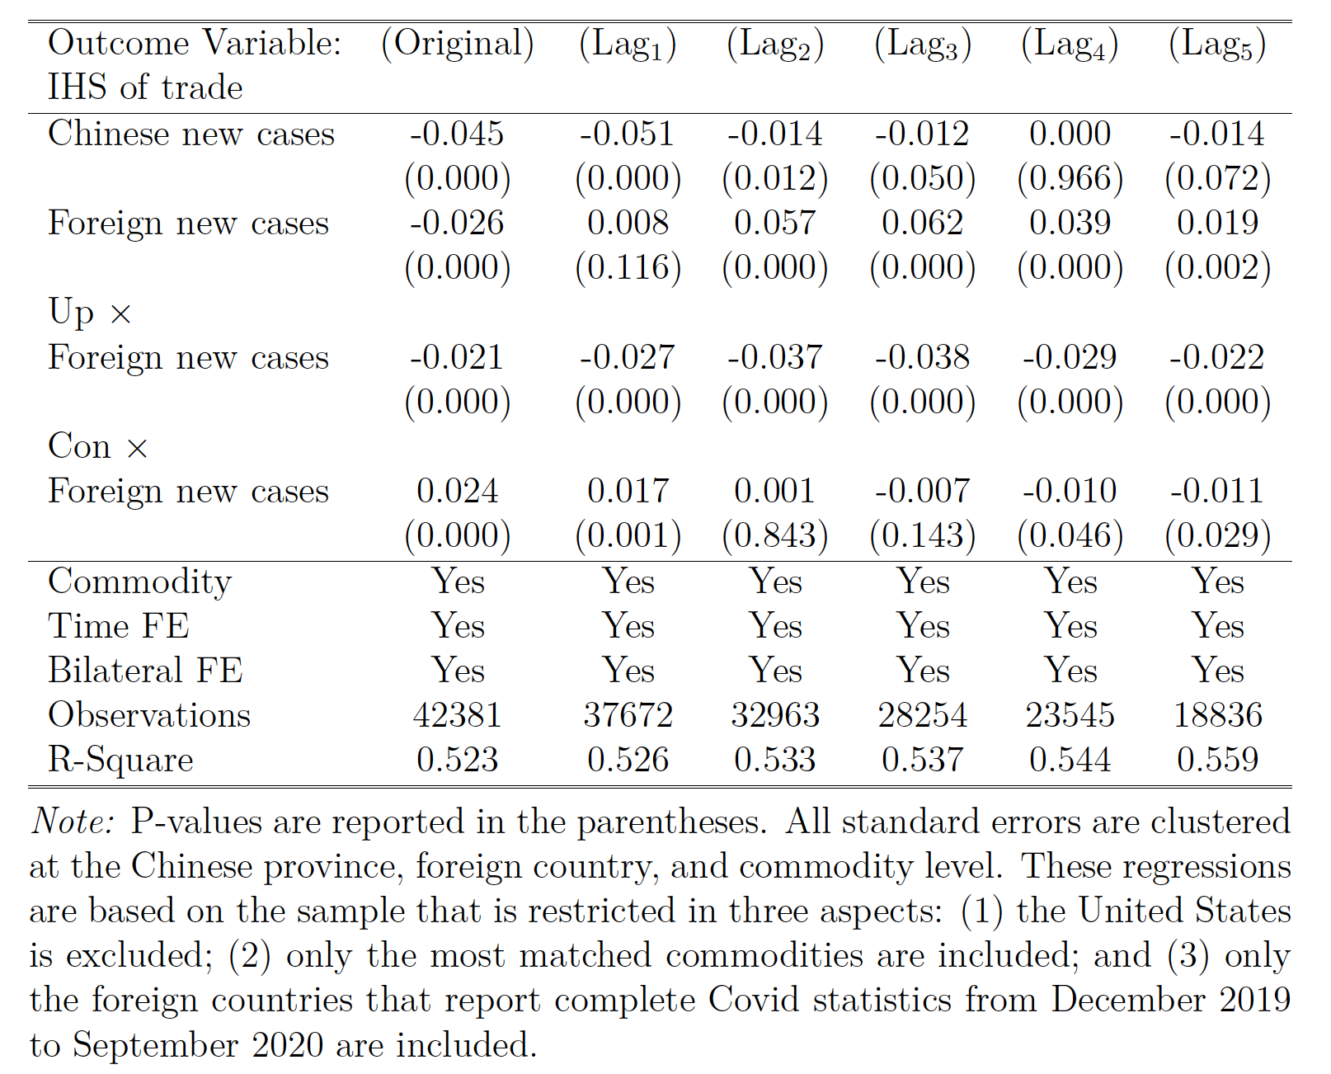
Time Lagged Effect

Slide 21
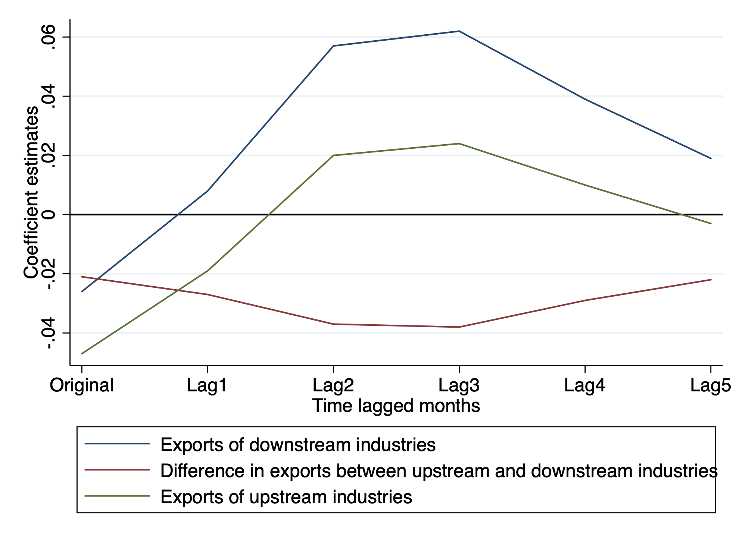
Time Lagged Effect

Slide 22
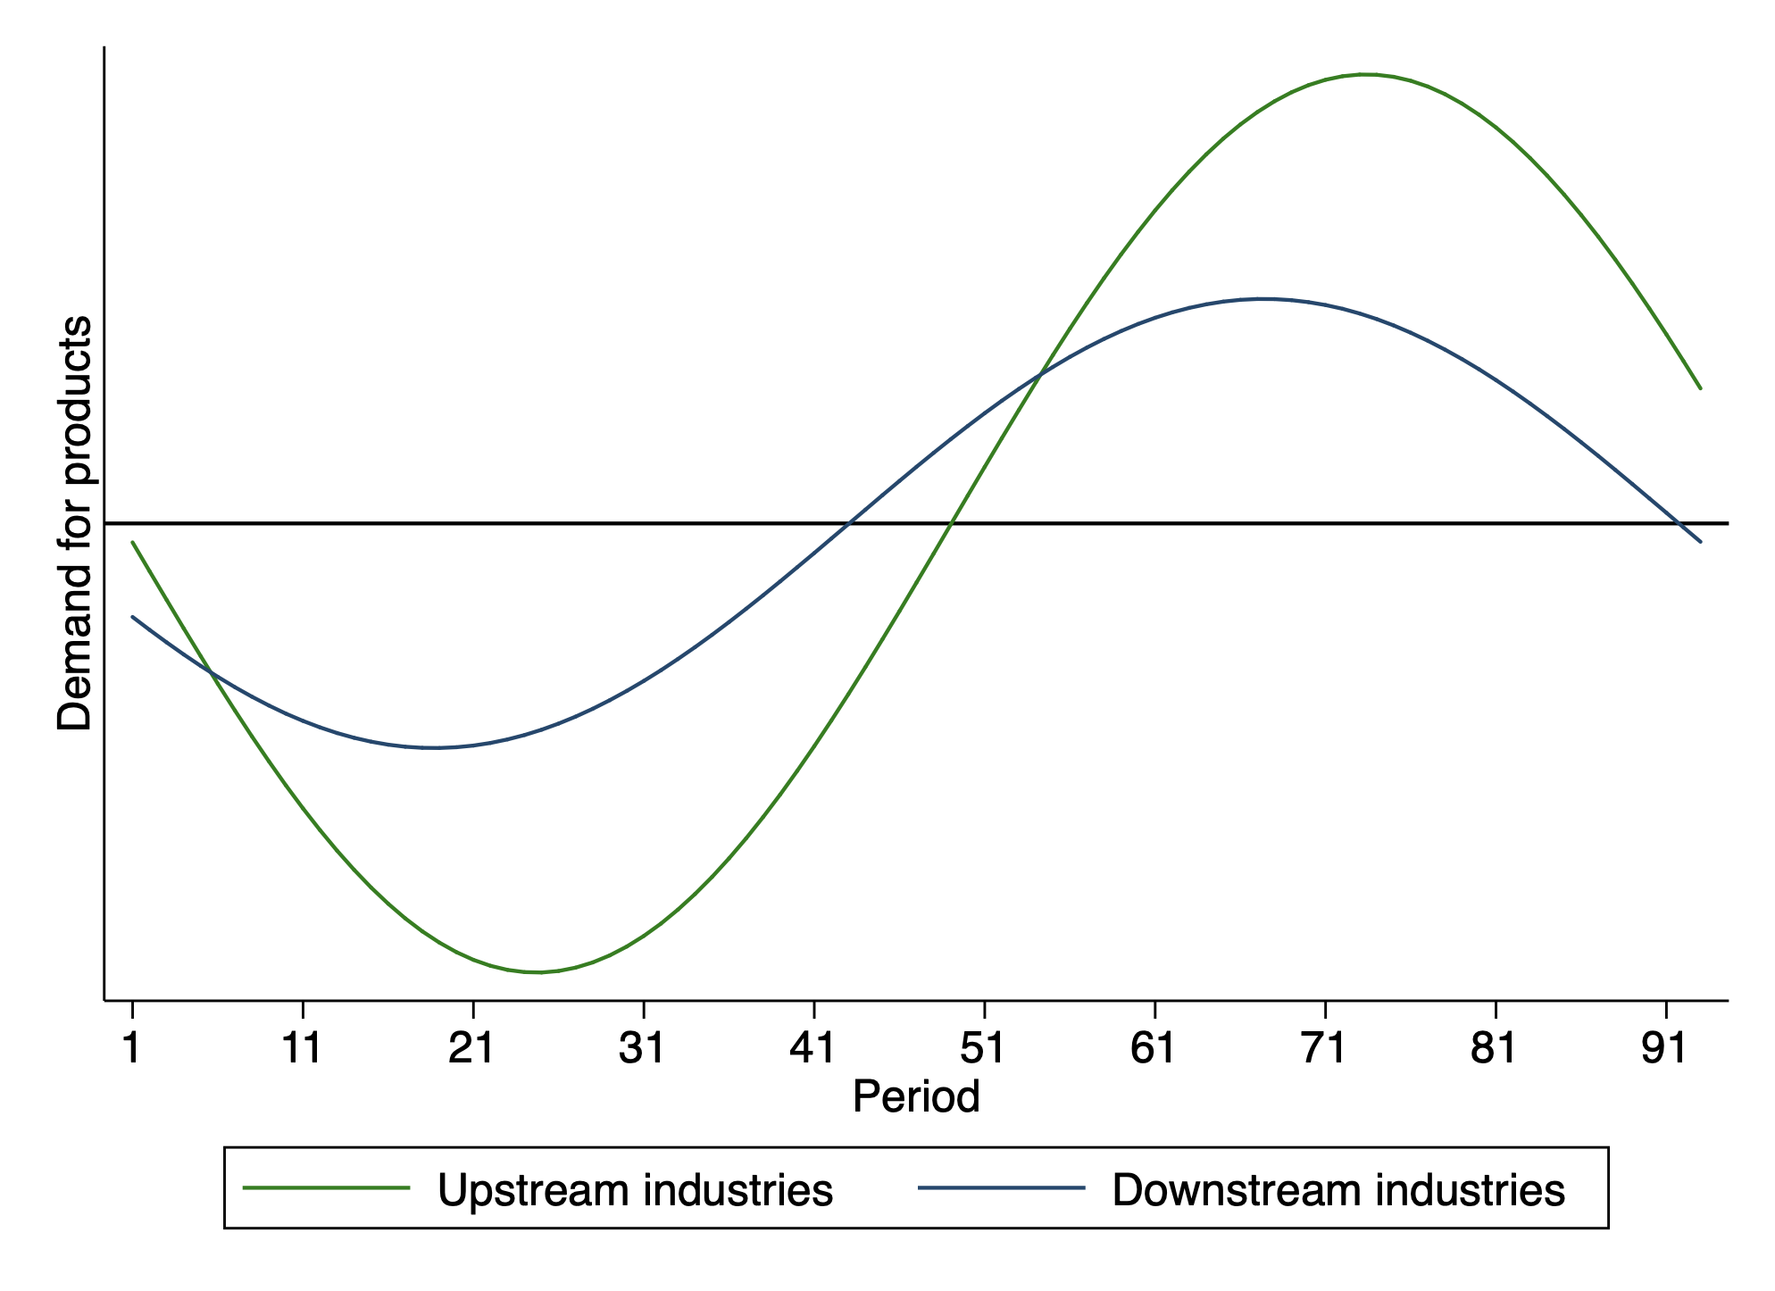
Time Lagged Effect V.S. Theoretical Model

Slide 23
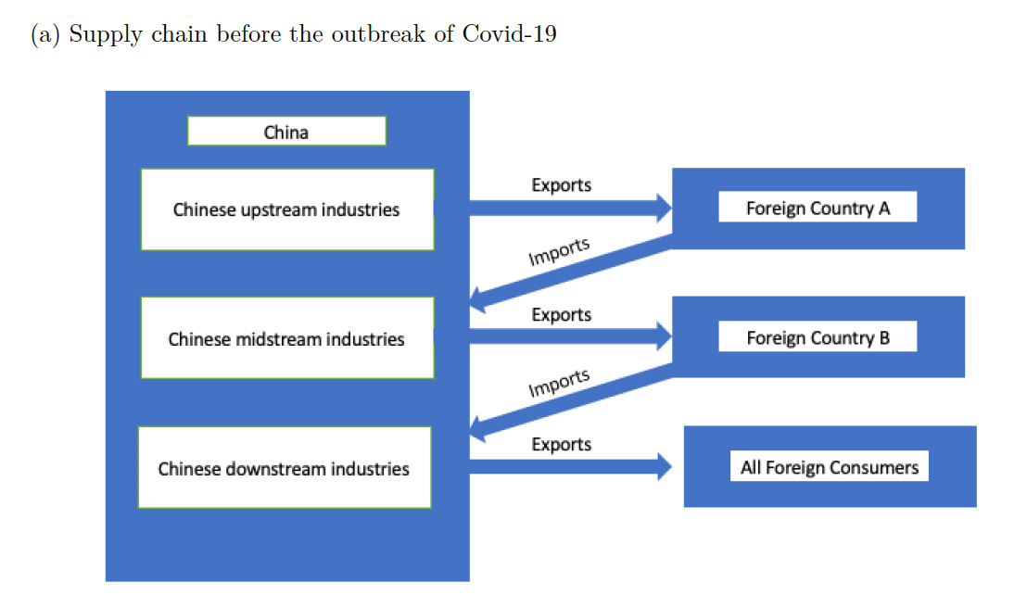
Import Substitutions

Slide 24
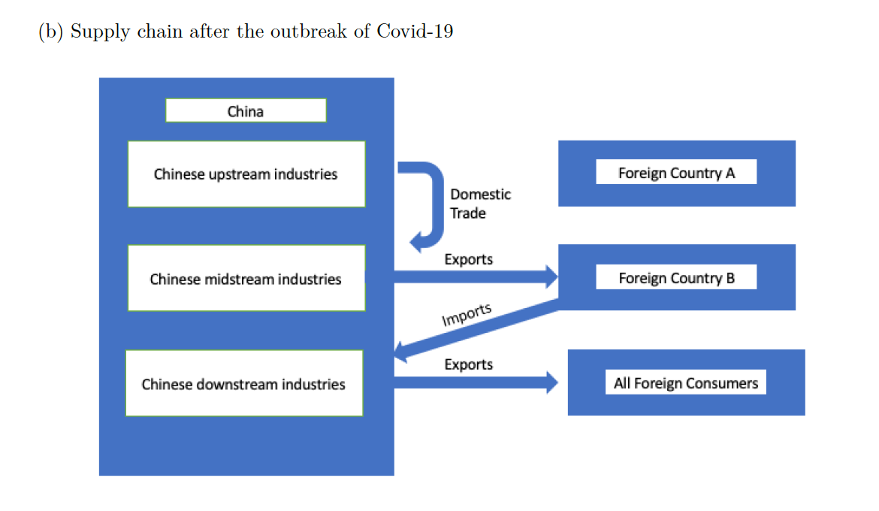
Import Substitutions

Slide 25
Conclusion
The bullwhip effect exists in the global supply chains after the outbreak of Covid-19 based on the analysis of Chinese exports.
The supply chains in which countries are geographically proximate and economically closely connected face to a greater bullwhip effect.
But we need the import substitution as supplemental theory to explain the whole story of the Covid-led demand shock on the global supply chains.

Slide 26
Thank you for your listening ☺ Any questions?

